Slide 1
Web security
03/05/2018
Jana Mineur – Lorenz Borgions – Matthias Van Meerbeek

Slide 2
Inhoud
Intro
Wat is security?
Web security

Slide 3


Security

Slide 4
Inhoud
Intro
Wat is security?
Web security

Slide 5


Web security
soorten
XSS
SQL-injection
directory traversal (path injection)
public files
PHP configuration file
error reporting
exposing PHP version

Slide 6
Web security
soorten
XSS
SQL-injection
directory traversal (path injection)
public files
PHP configuration file
error reporting
exposing PHP version

Slide 7
XSS
Cross Site Scripting
client site code
JavaScript
via URL
via database

Slide 8
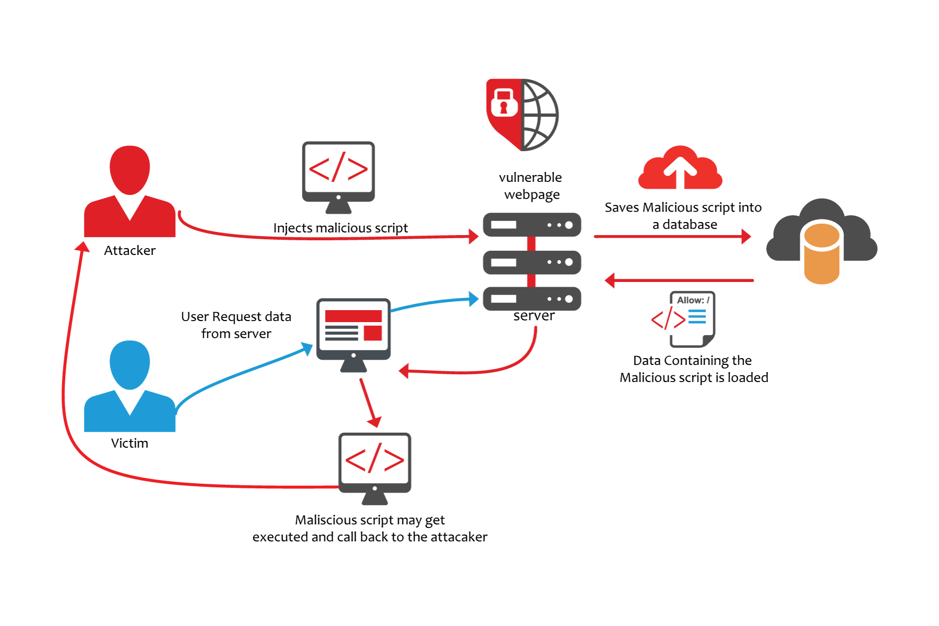
XSS

Slide 9
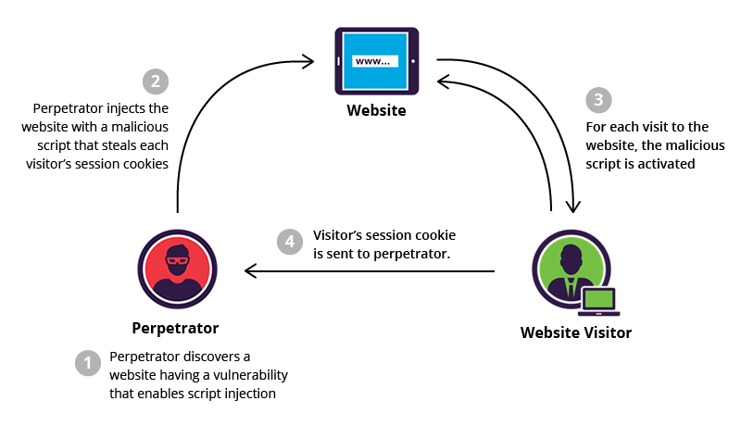
XSS

Slide 10
SQL-injection

Slide 11
Directory traversal

Slide 12
Public files

Slide 13
PHP configuration file

